Slide 1
Powershell Basics 4
Operators

Slide 2
Comparison Operators
“How does something compare to something else?”
Expression must come out as True or False
PowerShell is not cAsEsEnsitIve unless you make it
PS C:\> Help about_comparison_operator

Slide 3
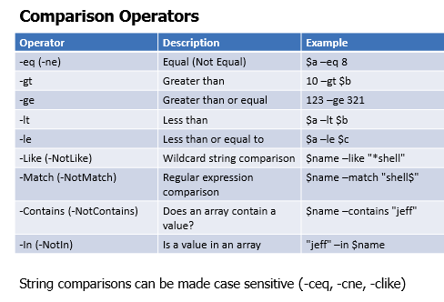

Slide 4
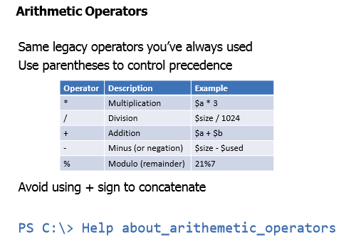

Slide 5
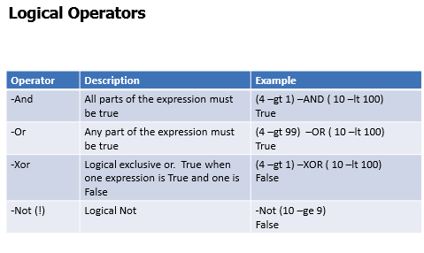

Slide 6
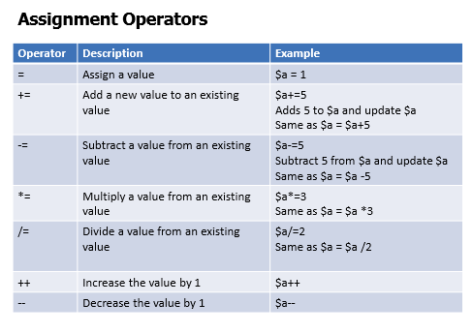

Slide 7
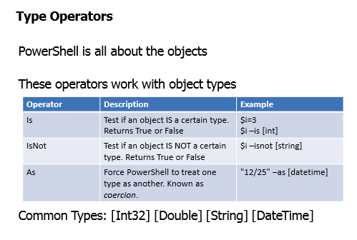

Slide 8
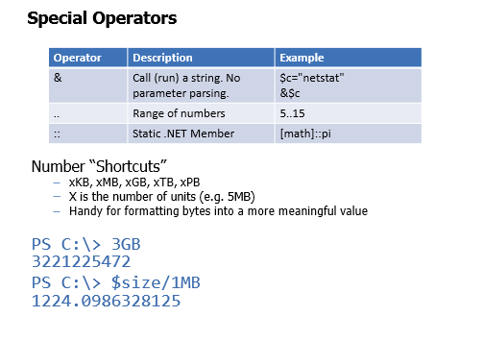

Slide 9
